Slide 1


Personal development Plan
Unit 2.4 Self motivation is key
Prepared by the research team

Slide 2
Welcome!!
Unit 2.4 Self motivation is key

Slide 3
Learning outcome
Students will be aware that we are responsible for our motivation level.

Slide 4
Now you worked on your personal development plan “first time”

Slide 5
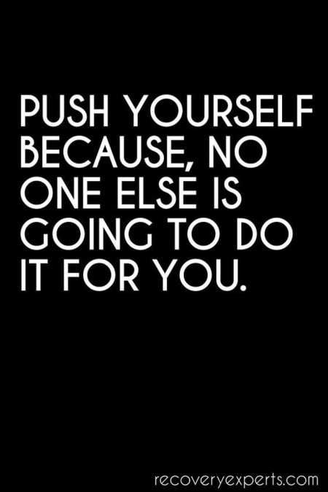
Self Motivation is the key :

Slide 6
Achieving Small Goals – source of motivation to accept next challenge
Type of goal | Completion Date | What is the goal | daily activities to achieve | Evaluation | Result (achieved / not achieved) | What went wrong ? | Why this happened?
Small | 1 week
Small | 1 month
Small | 3 months
Small | 6 months
Small | 9 months
Small | 1 year
Big | 3 year

Slide 7
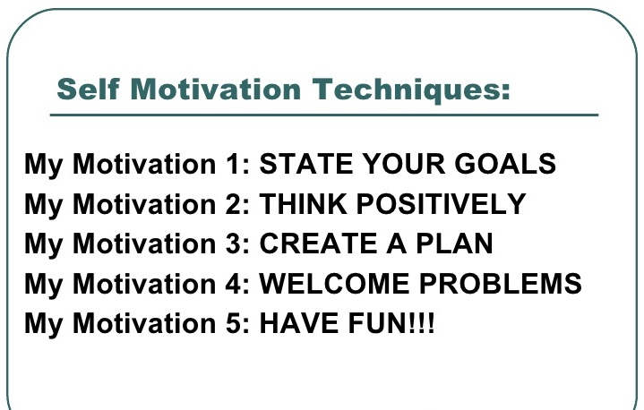
How to keep yourself motivated “Self Motivation Skills Development”

Slide 8

First thing is to change …….

Slide 9
How to keep yourself motivated ?
Dream (already started working on personal vision).
Make a concrete plan (already started working on personal development plan).
Start with the small step (through another table started establishing small goals / targets).
Never quit till you succeed (small target help to have this kind of attitude).

Slide 10

What to do now ?

Slide 11
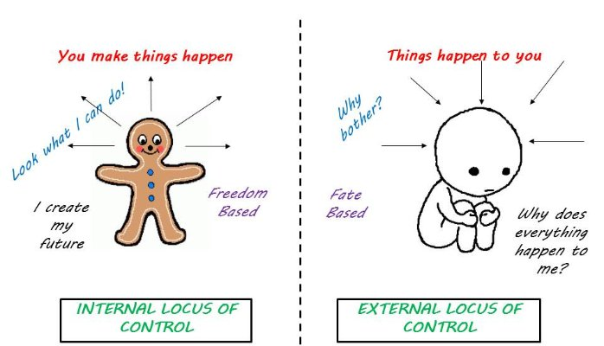
Self Motivation is possible “When your perspective is changed”

Slide 12
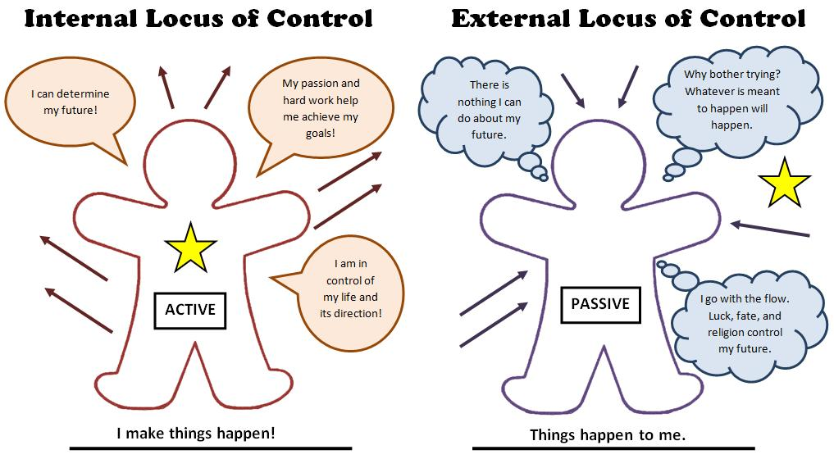
Self Motivation is possible “When your perspective is changed”

Slide 13
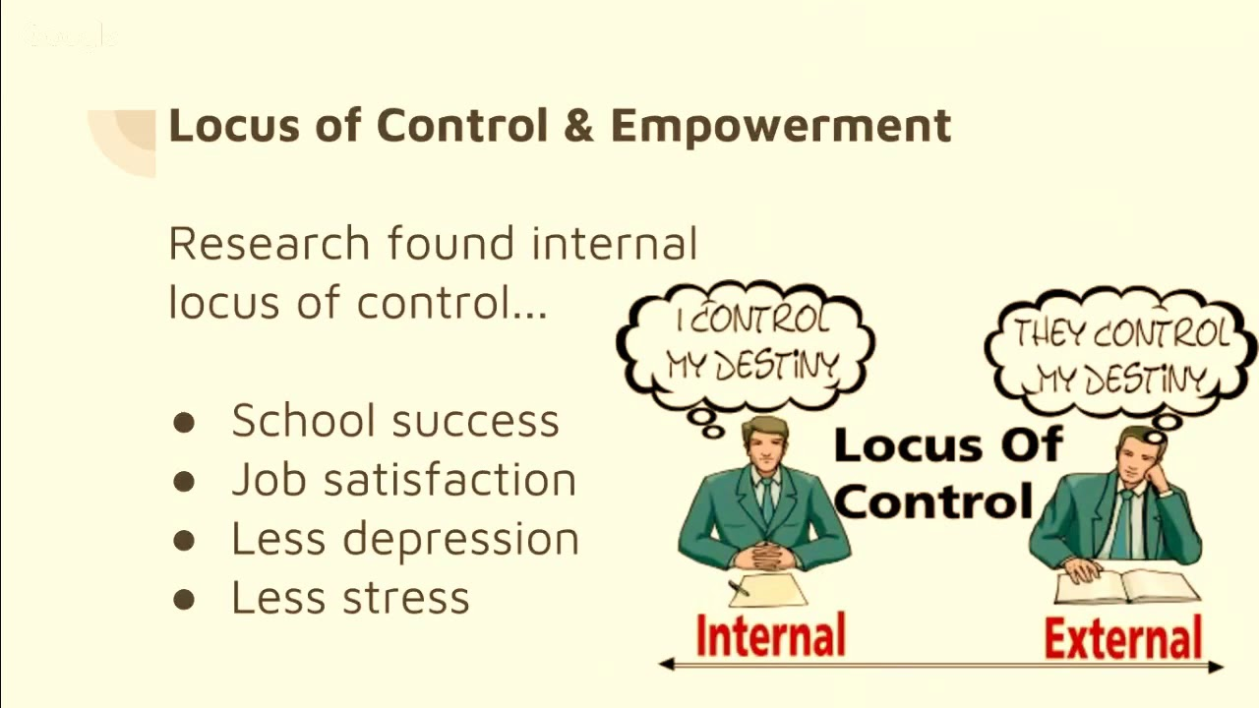
When your perspective is changed from External to Internal locus then you have set your life long goal then self motivation skills will be developed and ultimately you will perform better

Slide 14
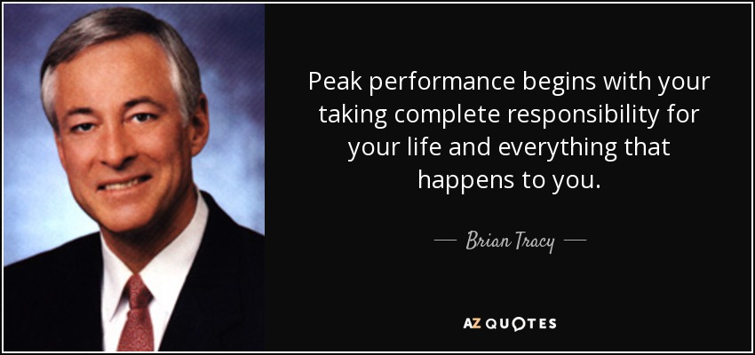
Peak Performance Not Possible without !

Slide 15
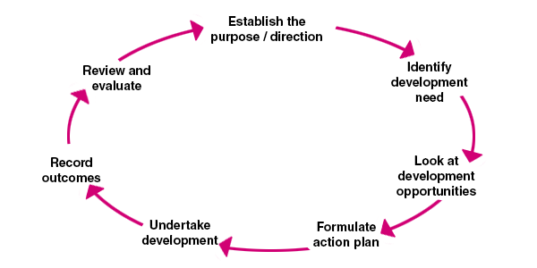
To get success –
keep visiting your personal development plan regularly

Slide 16
Quiz / Reflection
Do you think that you could achieve your Life Long Goal (Personal Vision) without having a “Personal Development Plan”. If yes then why if No then why?
Do you think that you could have motivation without having a personal vision ? Explain.
3. Do you think that peak performance is possible without having a motivation ? Explain.

Slide 17
Thank you
End of week

